Slide 1

Sending a Thank You Letter

Slide 2

Why send a thank you letter?
It shows your appreciation & gratitude
It can help you stand out
It confirms your interest in the job

Slide 3
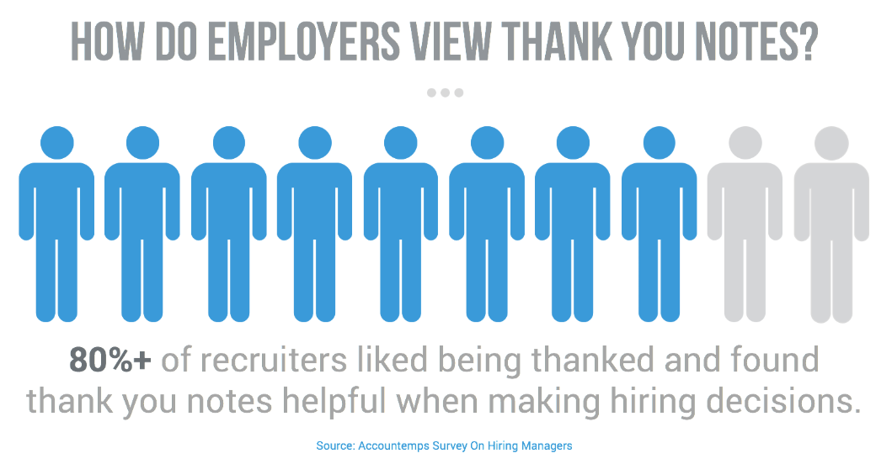

Slide 4
When to send a Thank You Letter?
Send it after every interview within 24 hours, while the interview is still fresh in your mind
Send it to everyone with whom you interviewed
Ask the recruiter if he/she can provide you with the email addresses
Ask the lead interviewer for the email addresses of the individuals who participated
You can also ask HR (Human Resource department)
Research online: the company website or LinkedIn

Slide 5
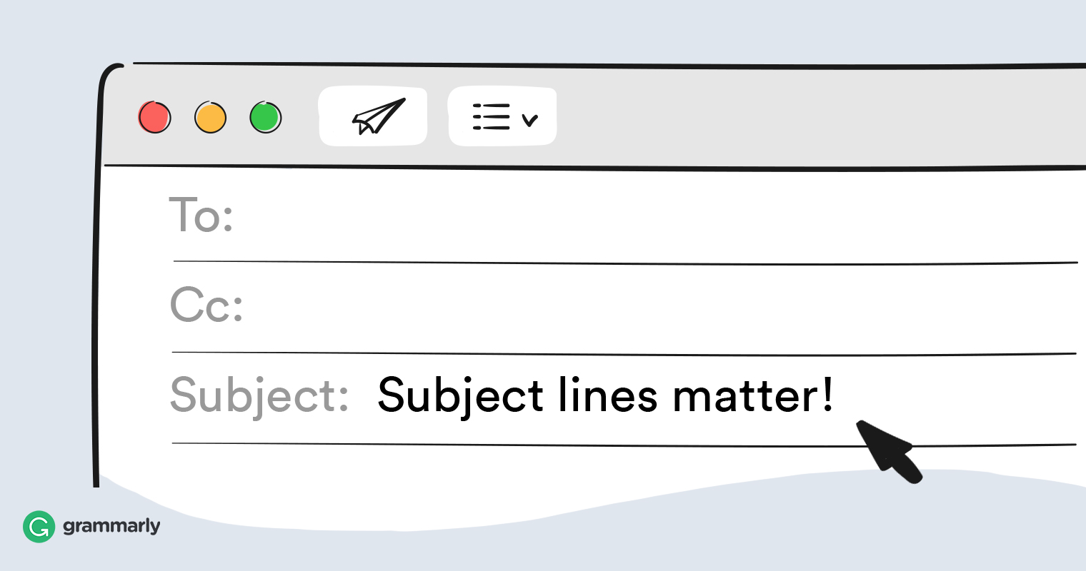
Use a Professional Subject Line
Use one of the following:
Thank You – First Name Last name
Thank You- First Name Last name, Job Title
Thank You- Job Title, First Name Last name
Job Title, Thank You – First name Last name

Slide 6


Sample Thank You Letter
Dear [Interviewer’s Name],
Thank you so much for taking the time to talk with me today. I loved getting to hear about [interesting thing you learned from this person] and was especially impressed by [quality or trait of the company or team that made you even more eager to work there]. Our conversation reinforced my excitement to join [company] and help you all [achievement you would support in this role]. I look forward to hopefully working together in the future.
Best regards,
[Your Name]

Slide 7

Customize it!
Express why you want the job, write something personal and unique
Avoid the obvious: “My technical skills are a good fit for the position” because everyone interviewed is technically a good fit. Companies don’t waste time interviewing candidates that are not qualified.
Add clarifying details to any of your responses given during the interview (only if you feel it is necessary)
Customize it according to your experience during the interview
If you were interviewed by more than one person – don’t send an identical thank you letter to each person; have at least one sentence that is personal or unique to each one
If you have multiple interviews with the same company, send new Thank you letters following each round

Slide 8
Make sure you:
Send your email right away – within 24 hours.
Make sure each individual interviewer gets a thank you.
Provide links to your personal sites such as LinkedIn etc.
You are a professional and it should be reflected in your writing.
Keep your message short and focused.
Use Grammarly.com to avoid sending misspelled, grammatically incorrect emails.

